Slide 1
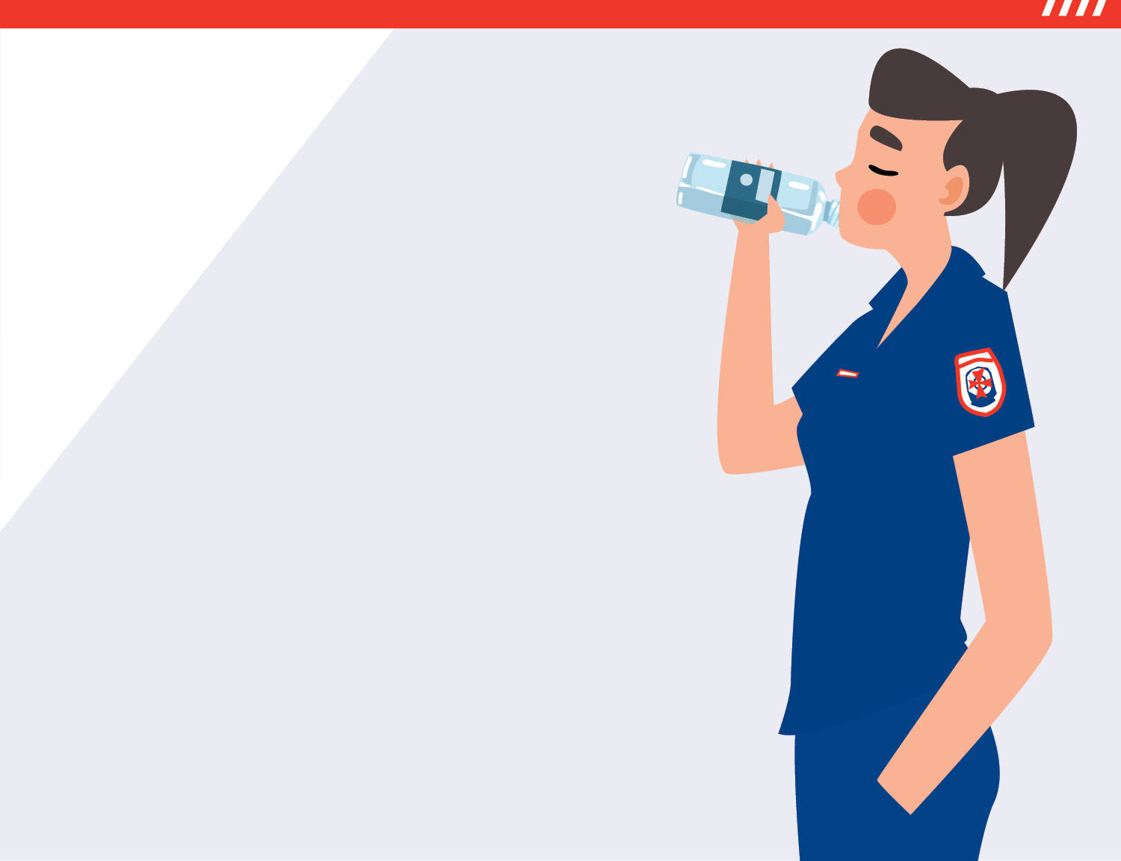
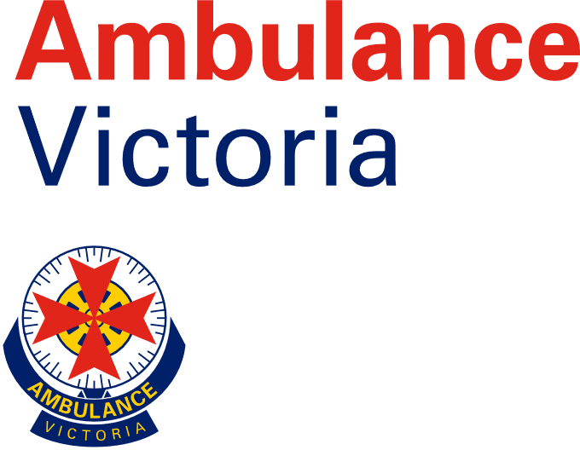
Play your part
Be summer smart
Whether you’re in the sun, by the water or on the road this summer, stay cool and stay safe.
#SUMMERDONERIGHT

Slide 2
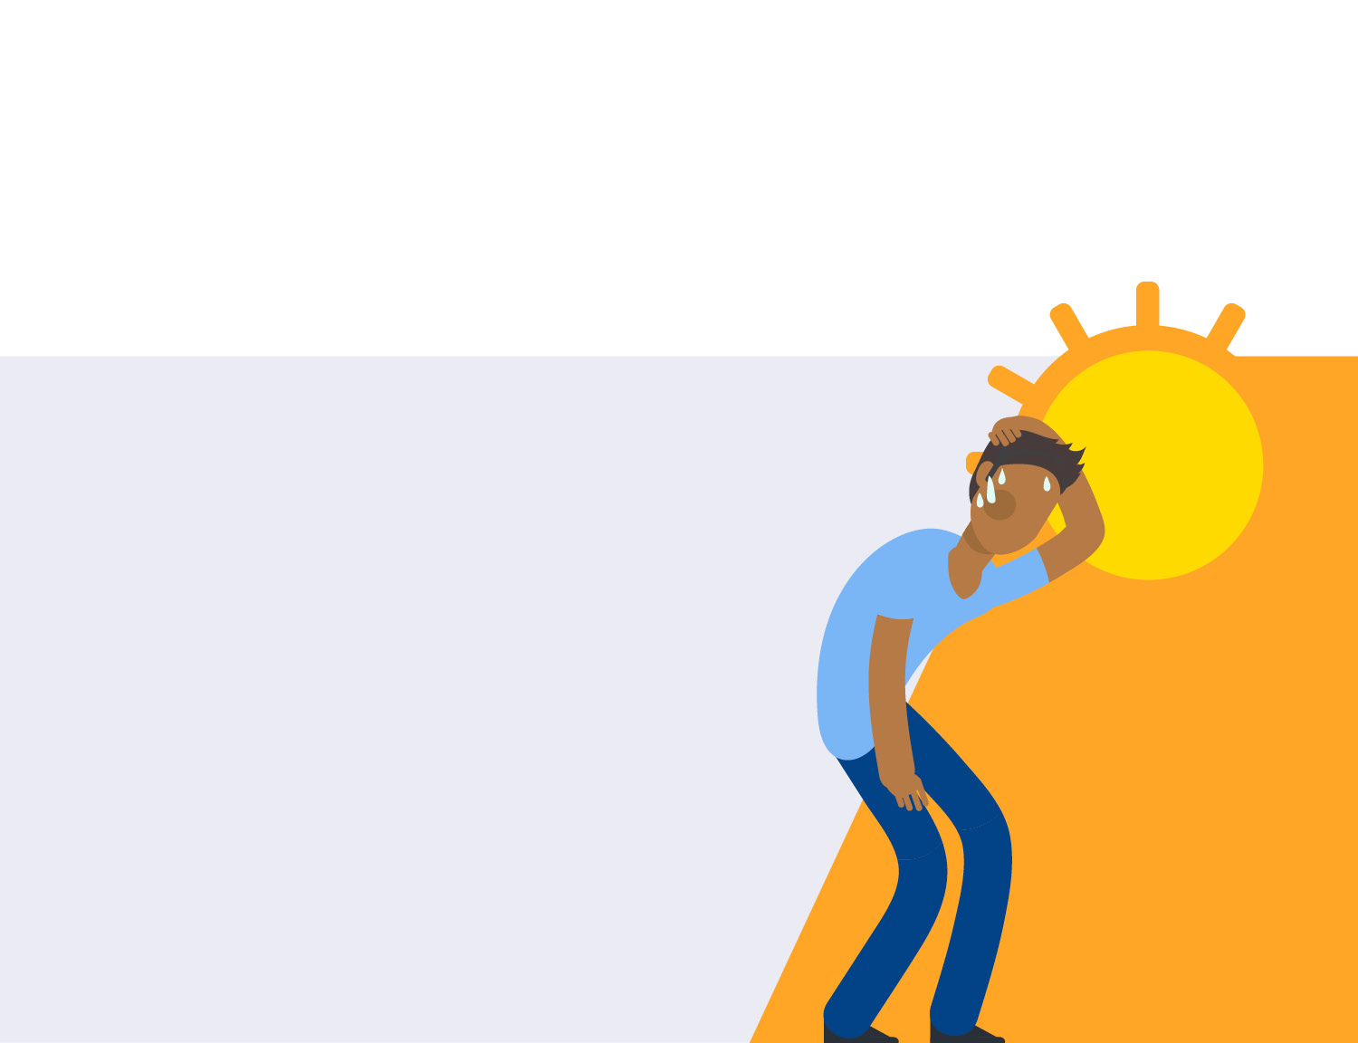
Heat related illness
Heat can cause:
Heat cramps
Heat exhaustion
This can lead to the life-threatening condition – heatstroke.
Heatstroke is fatal in up to
80%
Heat can also worsen the condition of someone who already has a medical issue such as heart disease or diabetes.
of cases

Slide 3
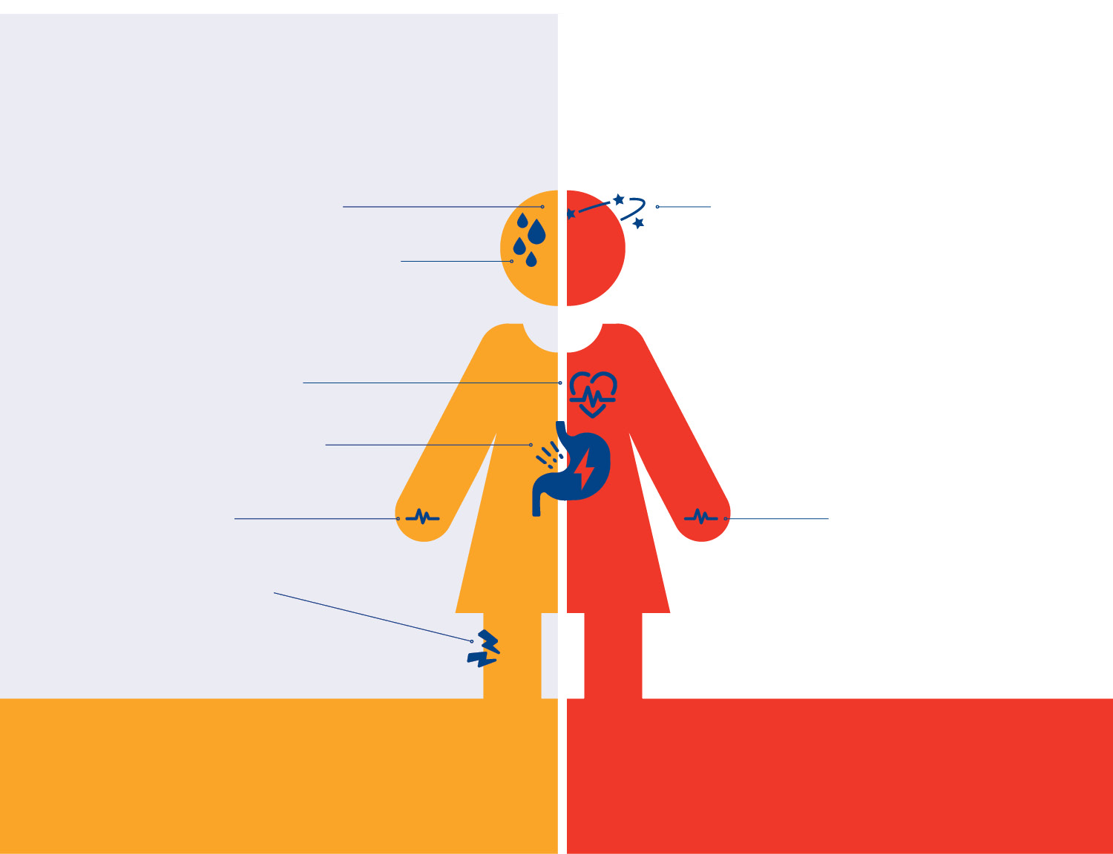
HEAT EXHAUSTION
OR
HEAT STROKE
Dizziness & headache
Pale complexion & sweating
Confused & delirious mental state
Sweating stops
Seizure
Rapid heart rate
Nausea & vomiting Fainting
Muscle cramps & weakness
Unconsciousness
Stroke-like symptoms or collapsing
Rapid strong pulse
Heatstroke is a life-threatening emergency, call Triple Zero (000).
What to do: Lie down in a cool area. If not vomiting, drink water.
Call NURSE-ON-CALL 1300 60 60 24.
What to do: Call Triple Zero (000) immediately and follow the advice of the calltaker.

Slide 4
About snakes
Always give snakes a wide berth and allow them the opportunity to flee
All snake bites should be considered a medical emergency
Most (but not all) Victorian snakes are venomous
Do not attempt to catch or kill a snake
Bite marks may not be obvious – seek help immediately if you suspect you have been bitten

Slide 5
Snake bite management
DO NOT!
DRSABCD
Call 000
Keep patient still and reassure them
Apply a pressure immobilisation bandage
Splint the limb to prevent movement
Wait with the patient until help arrives
Cut the bite site
Wash the bite site
Remove the bandage, even if the patient feels well
Apply a tourniquet

Slide 6
Tips for beating the heat this summer

Slide 7
Tips for beating the heat this summer
Stay hydrated
Drink water regularly throughout the day,
even if you don’t feel thirsty. Check the colour of your wee – if it’s pale you’re drinking enough
Have a water bottle with you if you go outside Drink alcohol responsibly
If your doctor normally limits your fluids, check how much you should drink during hot weather

Slide 8
Tips for beating the heat this summer
Keep cool
Use air conditioning and fans if possible. Protect yourself from the sun by wearing a hat and sunscreen. Avoid going out during the hottest part of the day
Use wet towels, put your feet in cool water and take cool (not cold) showers
Avoid intense activity like exercise, renovating and gardening

Slide 9
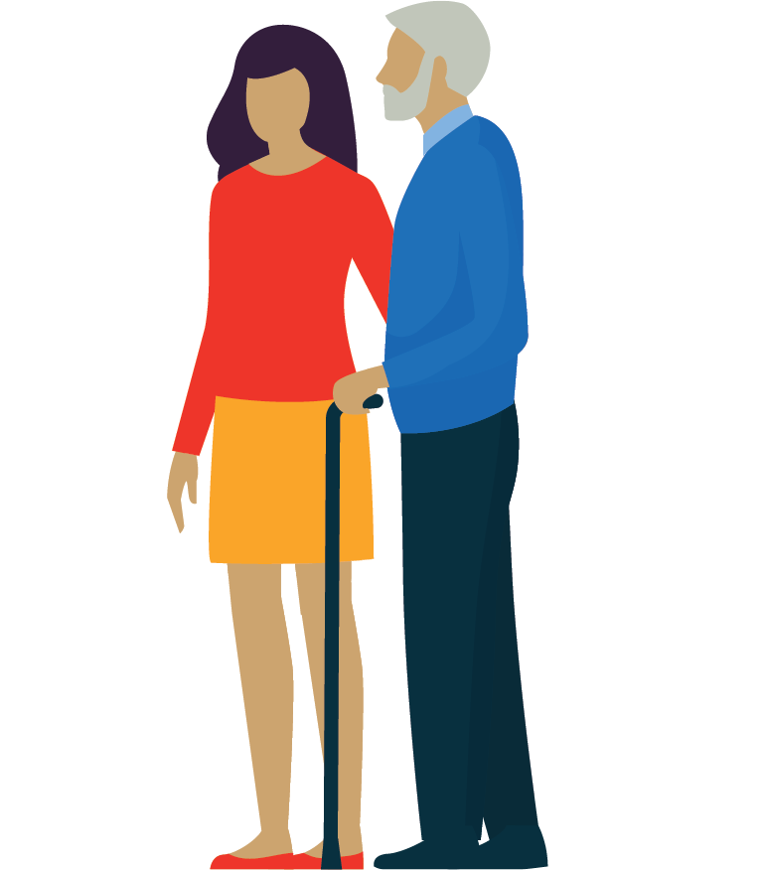
Tips for beating the heat this summer
Check in on others
Keep an eye on older people, those living alone, children and people with a medical condition
Call or visit them at least once on any extreme heat day
Encourage them to drink plenty of water
If you observe symptoms of heat-related illness, seek medical help

Slide 10
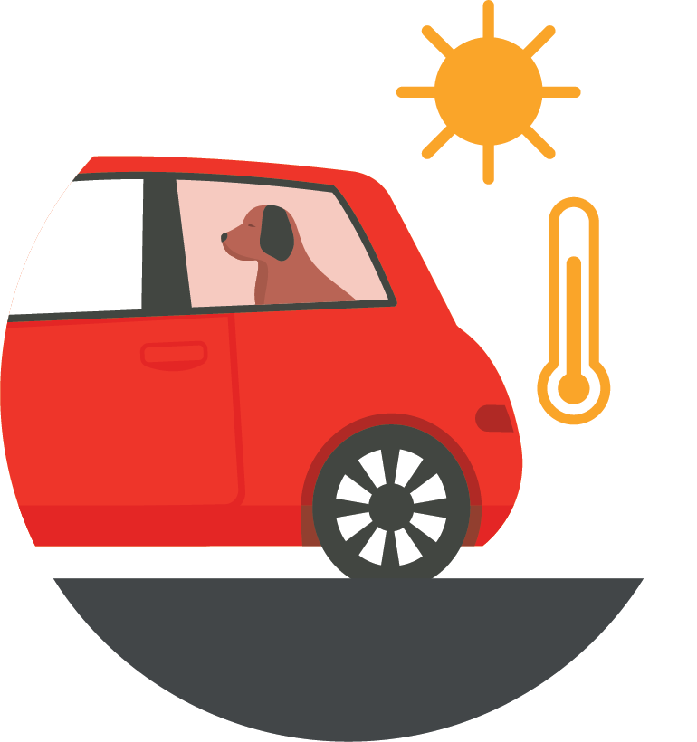
Tips for beating the heat this summer
Hot cars can kill
Never leave kids, older people or pets in a parked car – the temperature can double in minutes
A child’s body temperature rises three to five times faster than an adults
Even on a mild day, the temperature inside a parked car can be 20 to 30 degrees hotter than the temperature outside

Slide 11
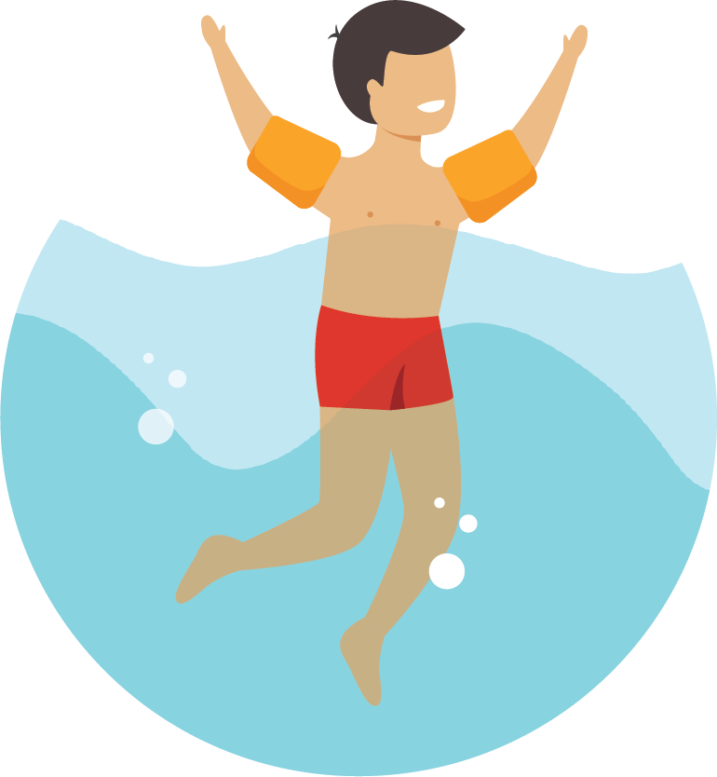
Tips for beating the heat this summer
Take care around water
Supervise children and keep an eye on friends when swimming and near water
Know the conditions and know your limits
Swim between the flags at the beach
Know the risks around water and never swim alone

Slide 12
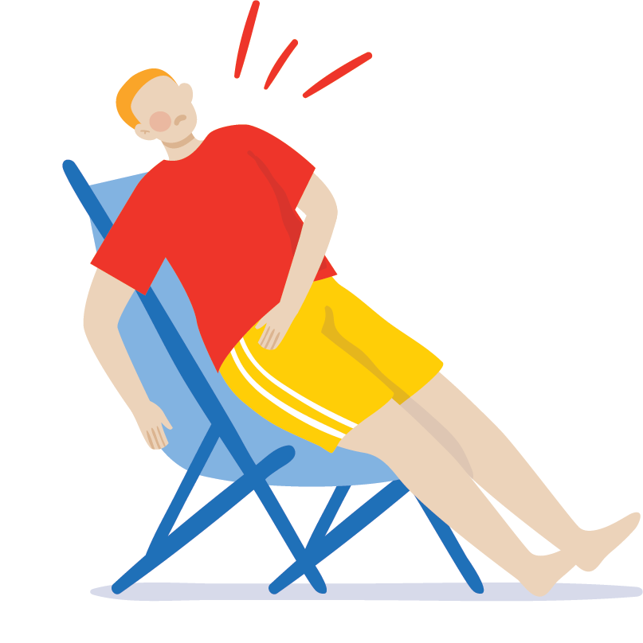
Remember beat the heat this summer by:
staying hydrated and drinking plenty of water
keep cool and protect yourself form the sun
check in on others that may need your help
never leave kids, older people or pets in a parked car
take care around water
Heatstroke is a life-threatening emergency
If you or someone else is experiencing seizures, confusion or stroke-like symptoms, collapsing or is unconscious, contact Triple Zero (000) immediately.
If you are feeling unwell, call NURSE-ON-CALL on 1300 60 60 24, or see your doctor or local pharmacist. For more information on staying safe in the heat, visit betterhealth.vic.gov.au

Slide 13
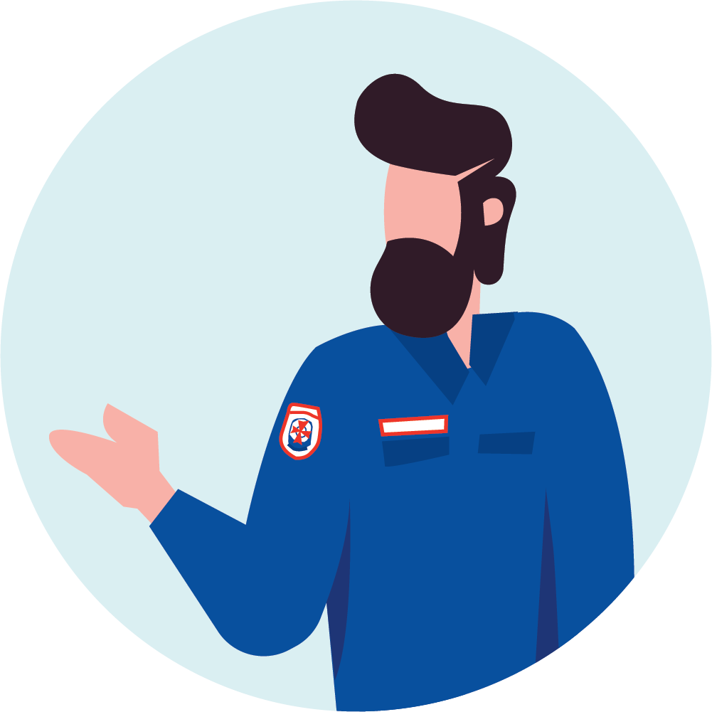
Play your part
Be summer smart
Thank you from Ambulance Victoria

